Slide 1
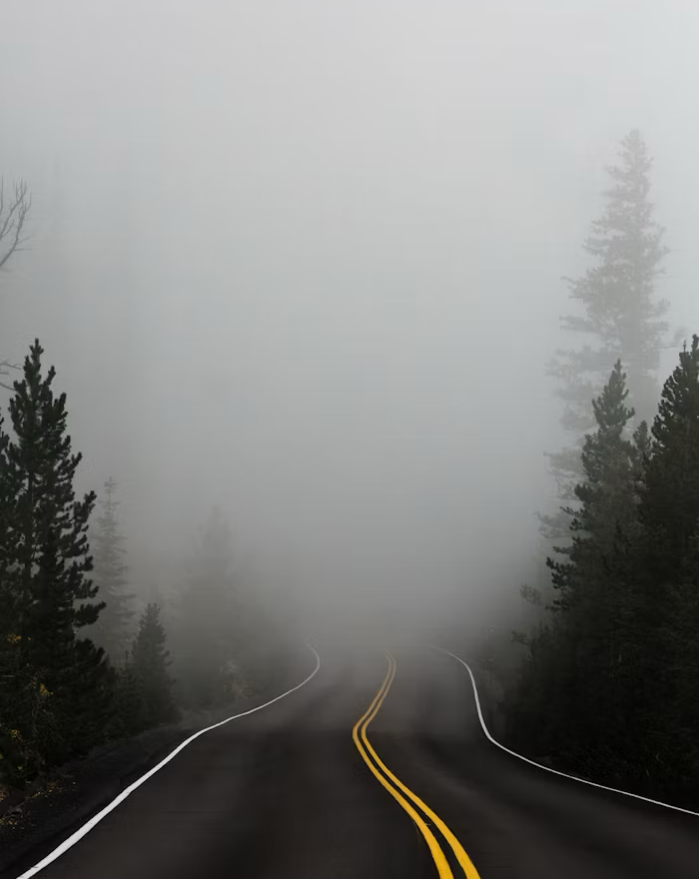

Through the Fire: How God Makes Us Better Than Before
Through the trials of life, God can ignite good things within us.
GROUP DISCUSSION

Slide 2
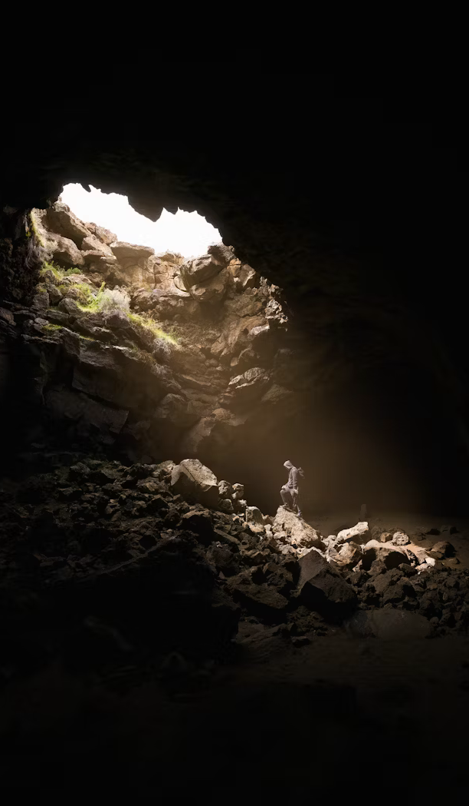

If there were a fire, what three things would you grab from your house? (excluding loved ones and electronics)
LESSON TITLE

Slide 3
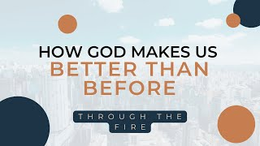

Slide 4
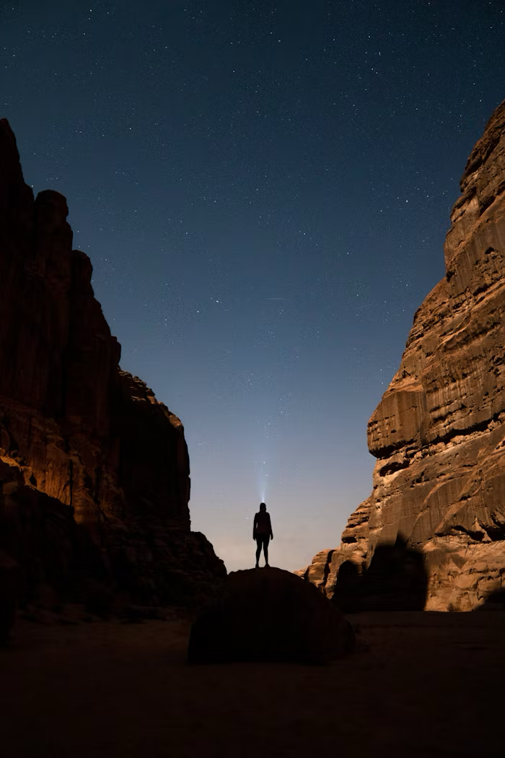
How am I handling the fires of life?
You’ve allowed our enemies to prevail against us. We’ve passed through fire and flood, yet in the end you always bring us out better than we were before, saturated with your goodness.
— Psalm 66:12 TPT
LESSON TITLE

Slide 5

How can I go through the fire and come out better?
I will bring that group through the fire and make them pure. I will refine them like silver and purify them like gold. They will call on my name, and I will answer them. I will say, 'These are my people,' and they will say, 'The LORD is our God.'"
— Zechariah 13:9 NLT
LESSON TITLE

Slide 6

What good things happen in my life when I go through the fire?
So be truly glad. There is wonderful joy ahead, even though you must endure many trials for a little while. [7] These trials will show that your faith is genuine. It is being tested as fire tests and purifies gold-though your faith is far more precious than mere gold. So when your faith remains strong through many trials, it will bring you much praise and glory and honor on the day when Jesus Christ is revealed to the whole world.
— 1 Peter 1:6-7 NLT
LESSON TITLE

Slide 7
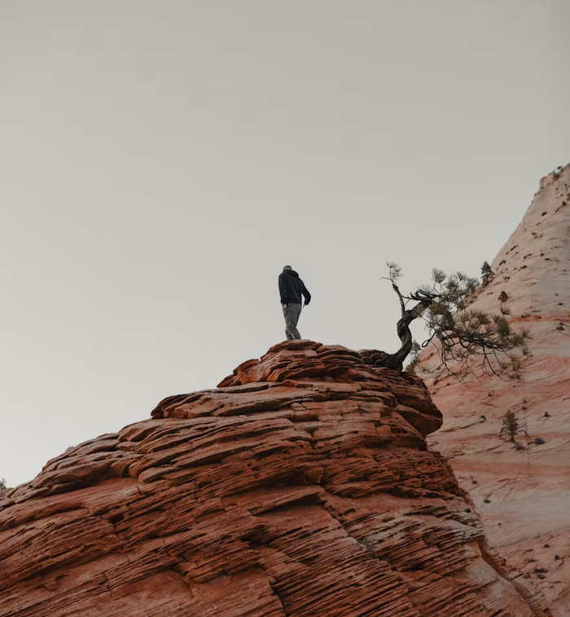
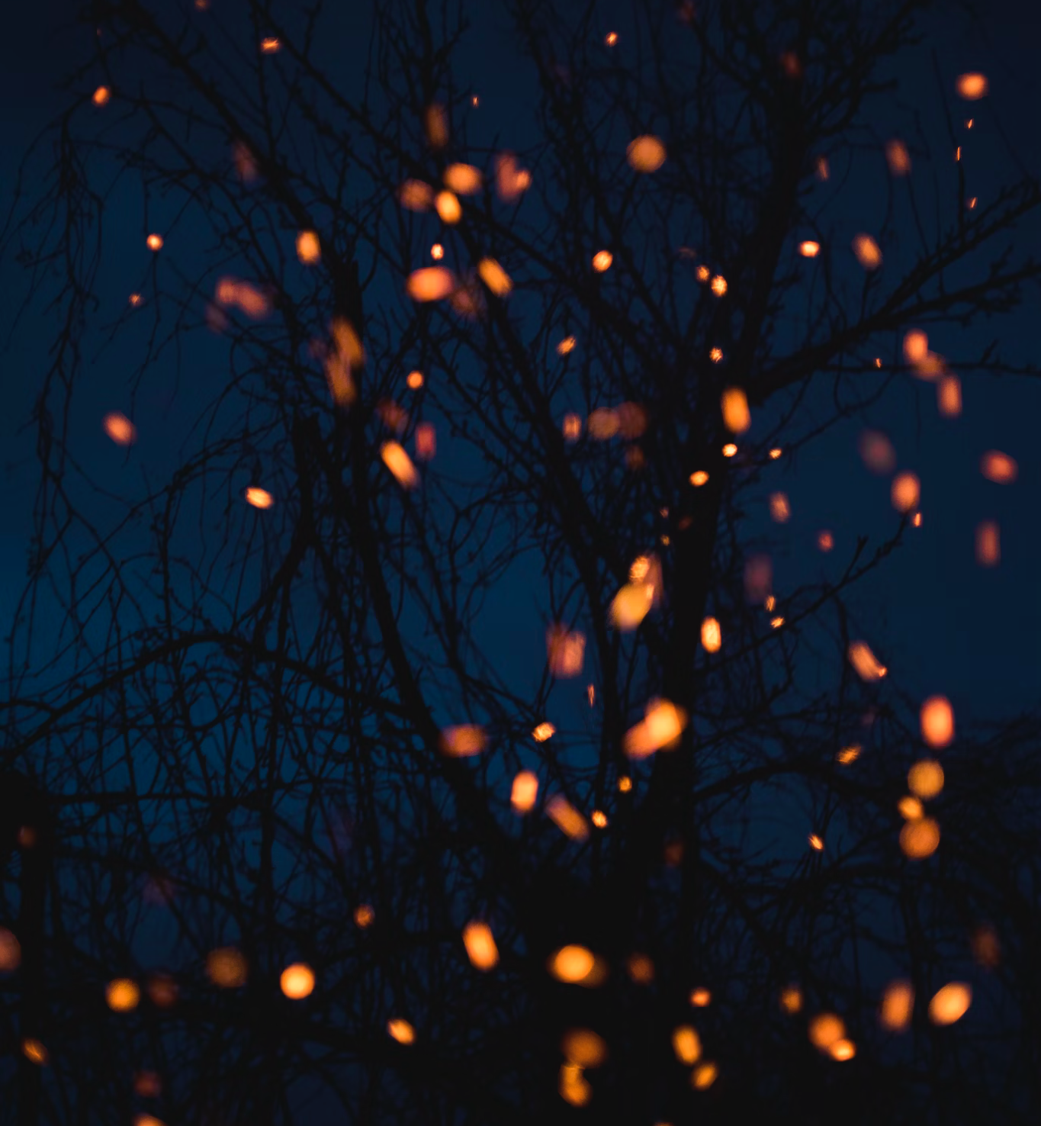
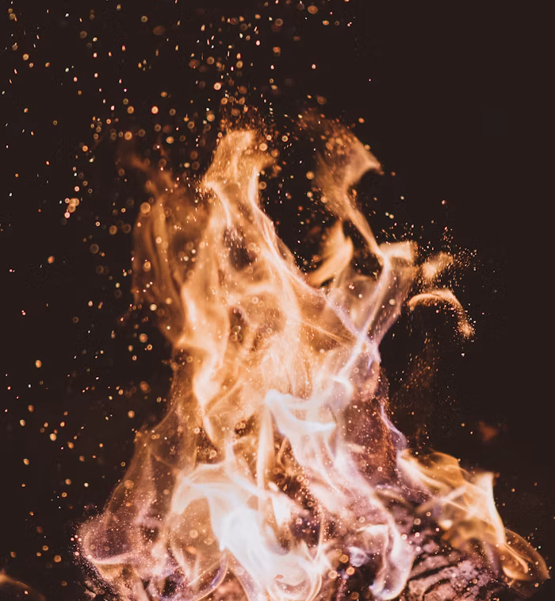
Reflect & respond.
Question #1
Question #2
Question #3
What are my current fires/trials?
What needs to get burned up? Examples: Pride, Insecurity, Bitterness, Fear of failure, Compromis
What needs to get ignited? Examples: Focus on God, Friends, Purpose
LESSON TITLE

Slide 8


Keep growing.
Practical #1
Practical #2
Pick two or three friends to talk to this week about being a team that goes through the fire together.
Ask your friends for new, creative ways that you can attach to God through the fire this week.
LESSON TITLE

Slide 9






Dive deeper with Deep Spirituality
Read the study: Trust The Process: How God Prepares Us For Our Destiny.
deepspirituality.com

