Slide 1



How to Build Family
Three lessons from the Bible that will build healthy, happy relationships
GROUP DISCUSSION

Slide 2



What’s one word that describes your family growing up? Why?
LESSON TITLE

Slide 3


Slide 4


Contributing: Families grow when everyone knows their role.
Instead, we will speak the truth in love, growing in every way more and more like Christ, who is the head of his body, the church. [16] He makes the whole body fit together perfectly. As each part does its own special work, it helps the other parts grow, so that the whole body is healthy and growing and full of love.
— Ephesians 4:15-16 NLT
LESSON TITLE

Slide 5

Being devoted: Families fight for each other.
Finally, as members of God’s beloved family, we must go after the one who wanders from the truth and bring him back.
— James 5:19 TPT
LESSON TITLE

Slide 6

Spending time: There’s no substitute for being available.
They spent their time learning from the apostles, and they were like family to each other. They also broke bread and prayed together.
— Acts 2:42 CEV
LESSON TITLE

Slide 7



Reflect & respond.
Which of these three ways to build family is most challenging for me? Why?
Contributing
Being Devoted
Spending Time
Embracing my special role in my family
Actively fighting for closeness
Being present and available
LESSON TITLE

Slide 8





Keep growing.
Week 1 - Contributing
Week 2 - Being devoted
Week 3 - Spending time
What is each person’s special role in our family? Have we been embracing it or resisting it? How would your family grow if each person did “their own special work”?
What are some things that create distance in our family? How can we help each other when one of us is wandering away?
How are we doing with spending quality time together? How present and available am I, and what could I do to be more available?
LESSON TITLE

Slide 9



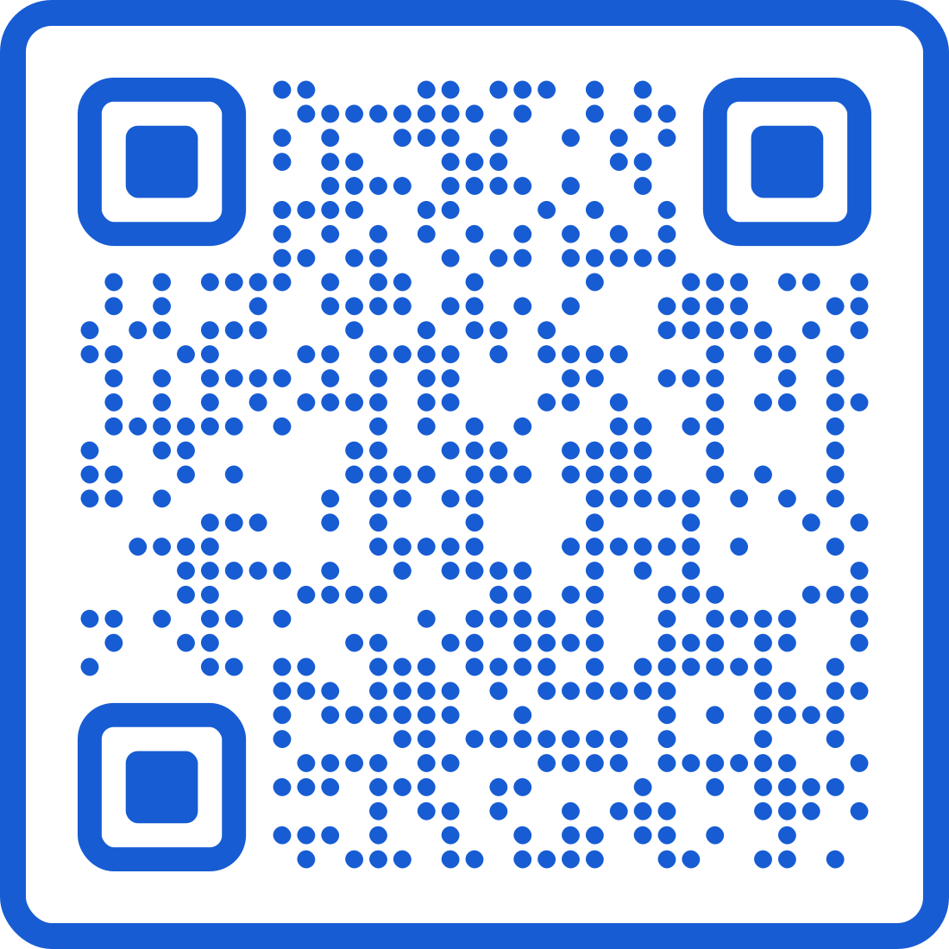


Dive deeper with Deep Spirituality
Read the devotional “When Family Becomes a Lifeline, Not a Limit” to get more inspired about God’s spiritual purpose for your family.
deepspirituality.com

