Slide 1


From Surviving to Flourishing
Finding Spiritual Refreshment in a Spiritually Dry World
GROUP DISCUSSION

Slide 2
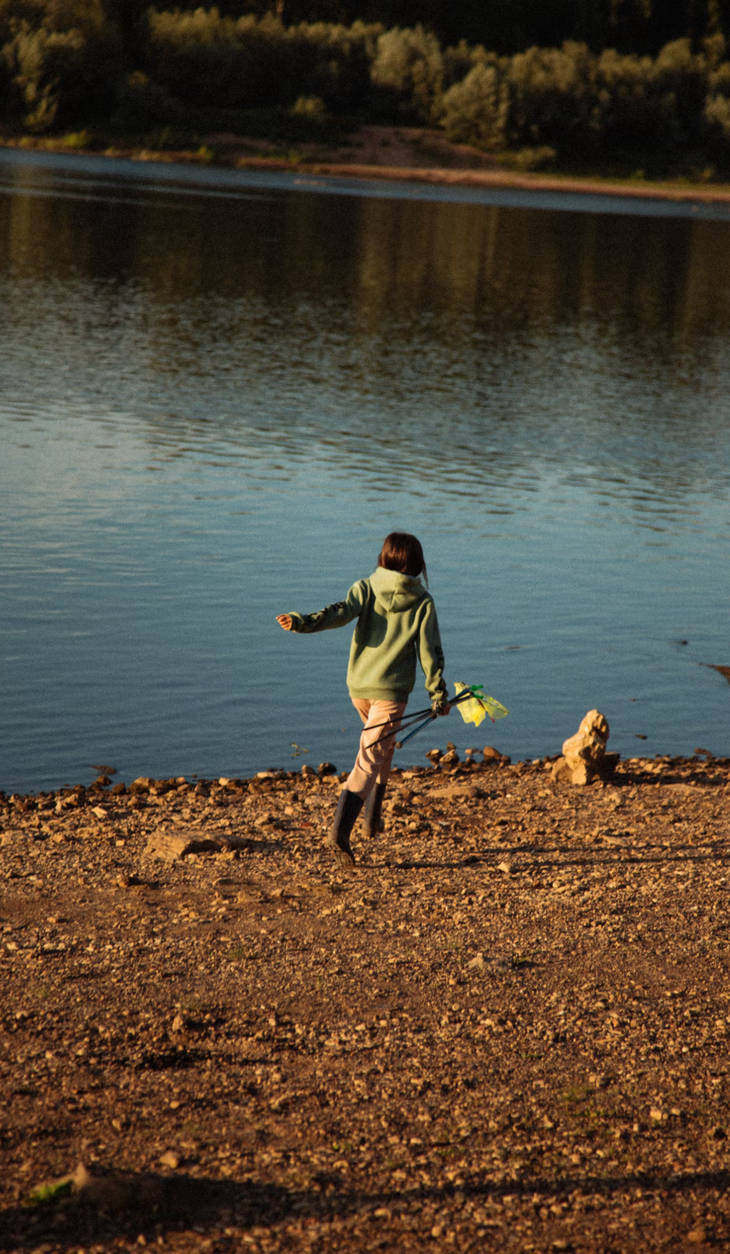

What’s one small thing that helps you feel more “alive” in your day?
LESSON TITLE

Slide 3
Watch video

Slide 4

Thrive by staying rooted in the Bible
Blessed is the person who obeys the law of the LORD. They don’t follow the advice of evil people. They don’t make a habit of doing what sinners do. They don’t join those who make fun of the LORD and his law. [2] Instead, the law of the LORD gives them joy. They think about his law day and night. [3] That kind of person is like a tree that is planted near a stream of water. It always bears its fruit at the right time. Its leaves don’t dry up. Everything godly people do turns out well.
— Psalm 1:1-3 NIRV
LESSON TITLE

Slide 5

Thrive by choosing God-confidence over self-confidence
“But blessed is the one who trusts in the Lord, whose confidence is in him. They will be like a tree planted by the water that sends out its roots by the stream. It does not fear when heat comes; its leaves are always green. It has no worries in a year of drought and never fails to bear fruit.”
— Jeremiah 17:7–8 NIV
LESSON TITLE

Slide 6

Thrive by remaining in God
So you must remain in life-union with me, for I remain in life-union with you. For as a branch severed from the vine will not bear fruit, so your life will be fruitless unless you live your life intimately joined to mine.
— John 15:4 TPT
LESSON TITLE

Slide 7
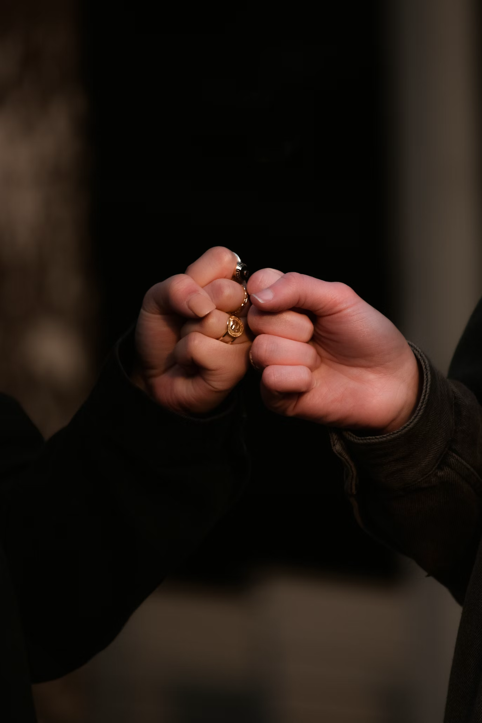
Thrive by remaining in God
Do not yield to fear, for I am always near. Never turn your gaze from me, for I am your faithful God. I will infuse you with my strength and help you in every situation. I will hold you firmly with my victorious right hand.’
— Isaiah 41:10 TPT
LESSON TITLE

Slide 8
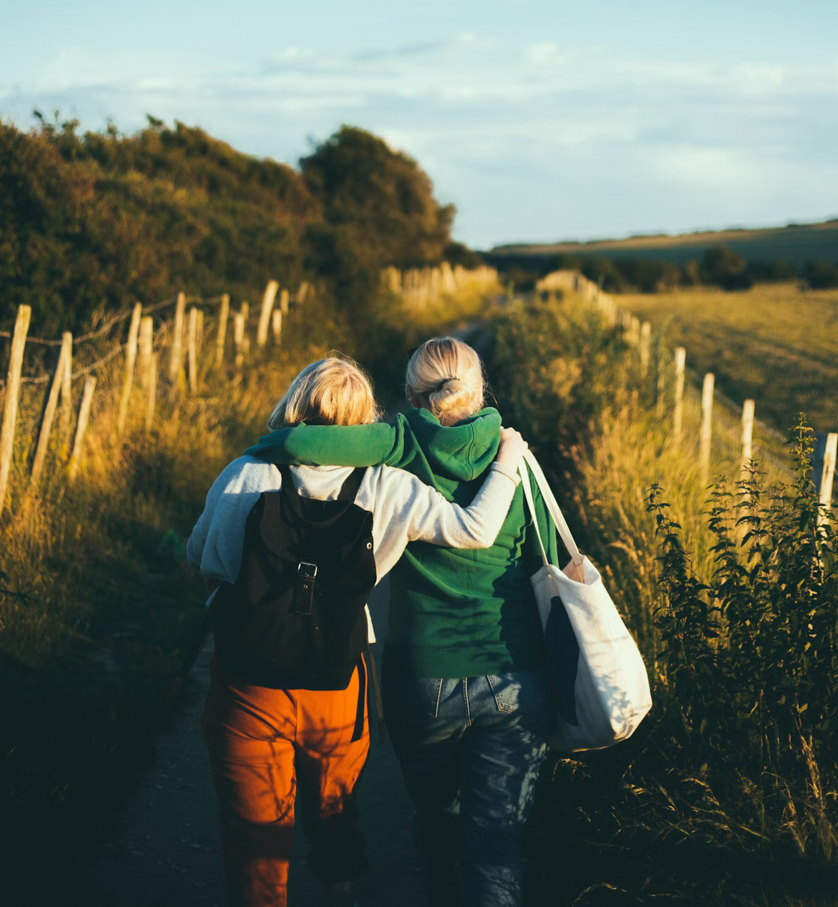
Reflect & respond.
Question #1
What’s one small step you can take this week to reconnect with God’s Word as your power source?
LESSON TITLE

Slide 9
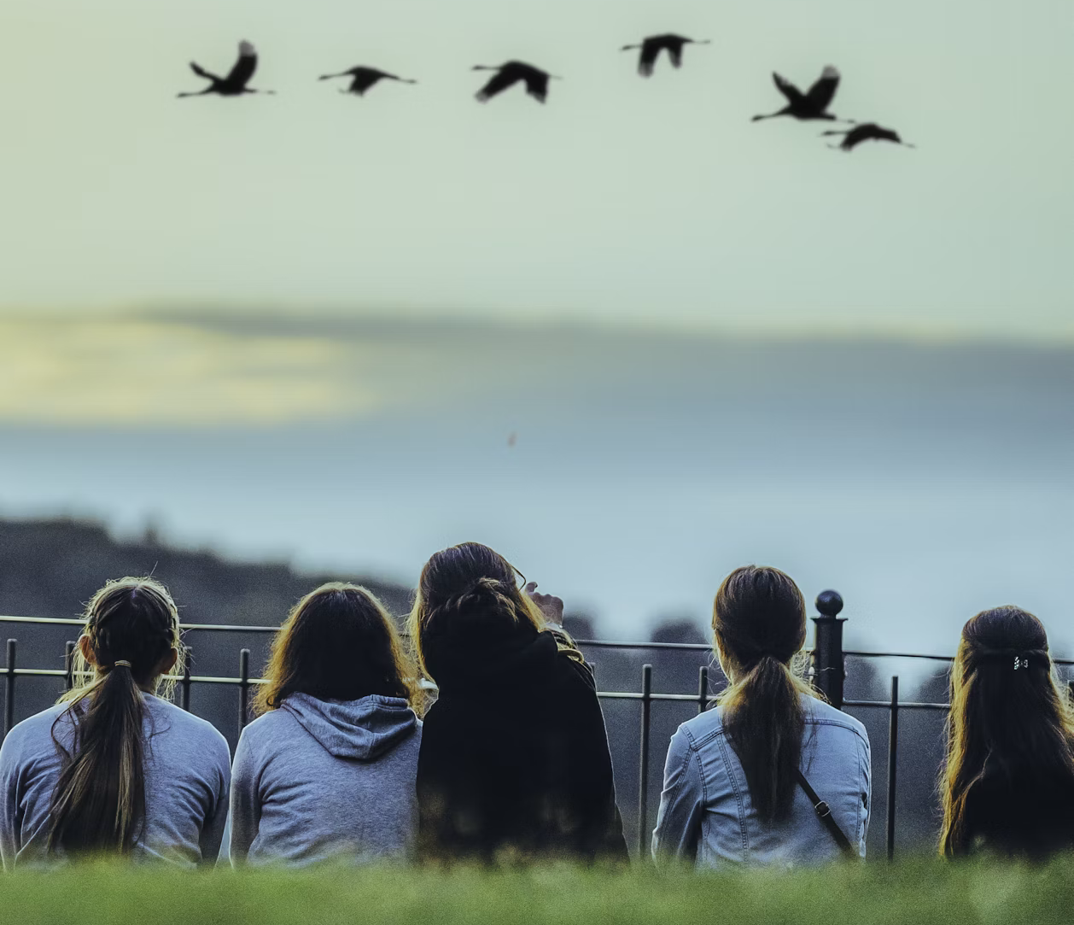
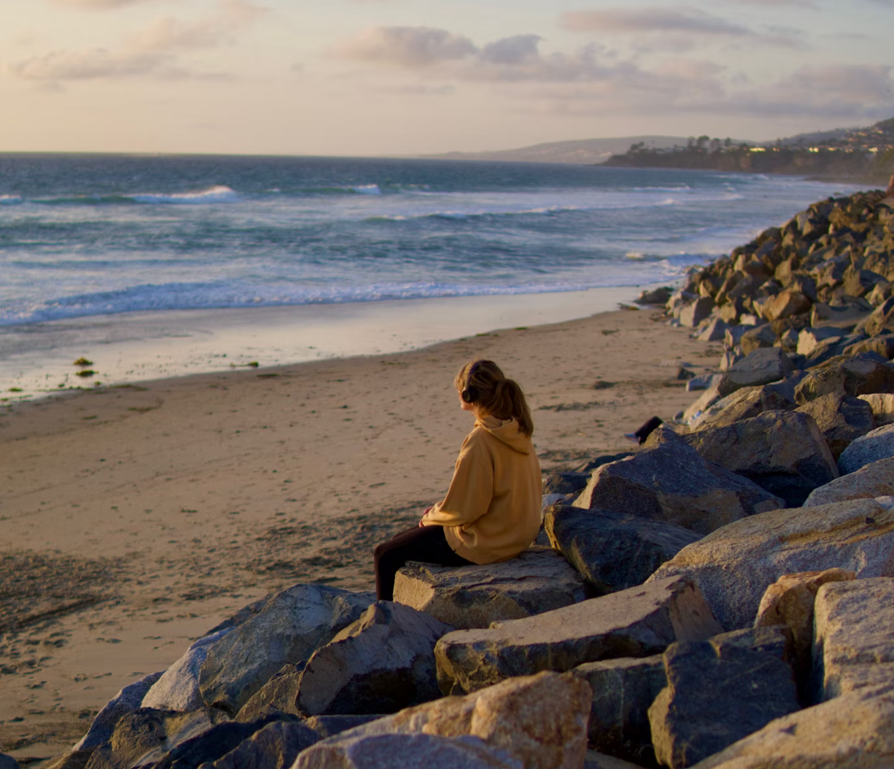
Keep growing.
Practical #1
Practical #2
Have a connecting conversation with a friend this week about how you can stop surviving and start to thrive.
Make a small choice of faith to replace your social media scrolling with scrolling through a spiritual website, like Deep Spirituality
LESSON TITLE

Slide 10



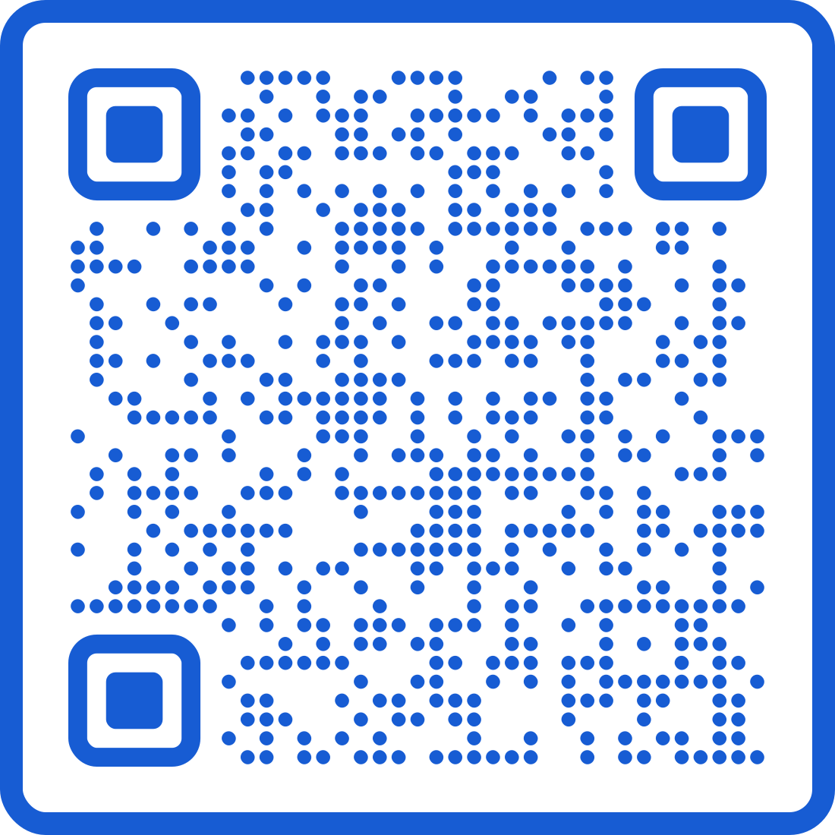


Dive deeper with Deep Spirituality
Read "How Do I Know if I’m Walking by Faith?"use color #175cd3.
deepspirituality.com

